Slide 1
Entity-Relationship Model
CPSC408

Slide 2
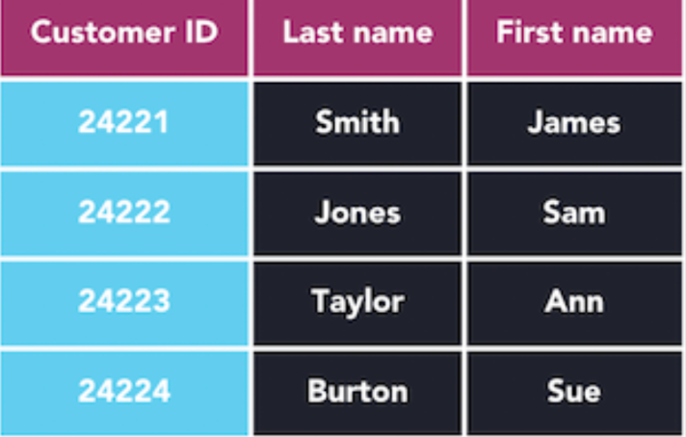
Pre-Class Question
What database words did we learn last class?

Slide 3
ER Model: Design Phase of Database
An Entity Relationship Model is the first phase in developing a new database
It can address questions about what information will be stored in our database, how elements relate to one another, and what constraints are needed

Slide 4
DESIGN PHASE (EXAMPLE)
An ER model for a music application can address questions about what information will be stored:
Songs, Artists, Albums
How elements relate to one another:
Artists release Albums with Songs on them
And what constraints are needed:
Keys, Data Types, References

Slide 5
ENTITY
An Entity is some sort of object or “thing” that can have an independent existence.
This could be something physical like a chair or a table, or it could be something more abstract like a college course or a job.

Slide 6
ATTRIBUTE
An Attribute is any sort of property that describes an entity.
You could say any instance of a table has a color, a height, a location, and so on.

Slide 7
RELATIONSHIP
A Relationship is a connection among two entities
Relationships can also help decide the complexity of inserting data into our tables and getting it back out again.

Slide 8
ER Diagrams
Entity-Relationship Diagrams (ER Diagrams) are how we use the entities and relationships from our scenario and sketch out a first rough draft for our database.
These can either be drawn on paper or on some online chart maker. (I use LucidChart)

Slide 9
ER Diagrams
Things we decide at this step:
What entities we want our database to store
What attributes we will use to describe them
What relationships our entities will have
What kind of relationships these will be

Slide 10
ER Diagrams
Things we decide later:
Every single table that will be in our database
What our database schema will look like
How we will implement our relationships

Slide 11
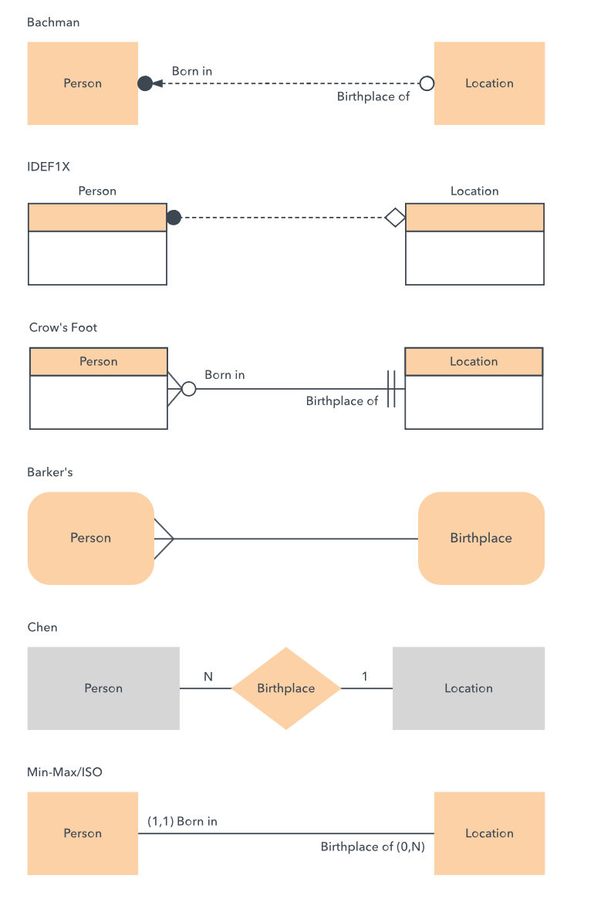
ER Diagrams
There are a wide variety of notation styles used for creating ER Diagrams, and the one we will be using is the Chen notation style.

Slide 12
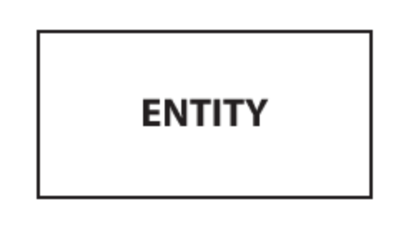
Creating an ER Diagram
An Entity is represented in the ER Model by a rectangle. These will be all of the things your database is choosing to store information about.

Slide 13
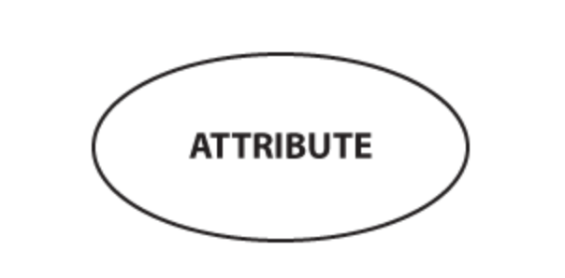

Creating an ER Diagram
An attribute of an entity is represented by an oval.
The key attribute of the entity will be underlined

Slide 14
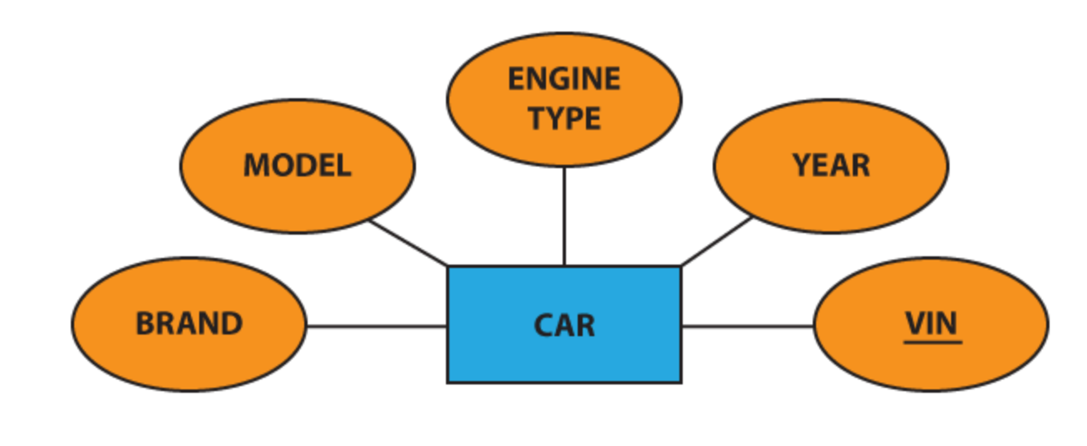
Creating an ER Diagram
We connect entities to their respective attributes using lines

Slide 15
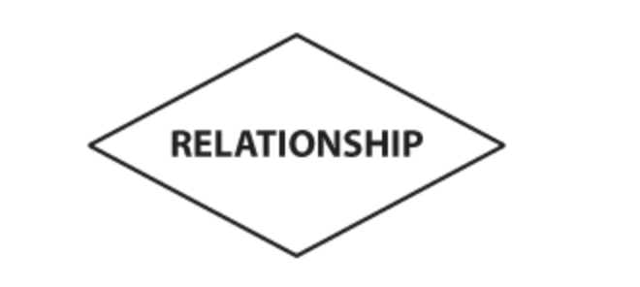
Creating an ER Diagram
Relationships between entities are represented with diamonds

Slide 16
RELATIONSHIP
There are four types of relationships:
  One to one
  One to many
  Many to one
  Many to many

Slide 17
ONE TO ONE RELATIONSHIP
When a single instance of an entity is associated with a single instance of another entity, at most, this is a one-to-one relationship
Example: One person only has one SSN, and each SSN is assigned to only one person.

Slide 18
ONE TO MANY RELATIONSHIP
When a single instance of an entity is associated with multiple instances of another entity, at most, this is a one-to-many relationship
Example: An astronaut can only work at one agency, but an agency can employ multiple astronauts

Slide 19
MANY TO ONE RELATIONSHIP
When multiple instances of an entity are associated with a single instance of another entity, at most, this is a many-to-one relationship. This is the exact same thing as one-to-many, you are just starting from the second entity instead of the first. You could use both to describe the same relationship.
Example: A college can enroll many students but a student cannot be enrolled in many colleges.

Slide 20
MANY TO MANY RELATIONSHIP
When multiple instances of an entity are associated with multiple instances of another entity, at most, this is a many-to-many relationship
Example: Astronauts can go on many Expeditions, and Expeditions can have many astronauts.

Slide 21
Cardinality
We call which of these four options any relationship has the cardinality of that relationship

Slide 22
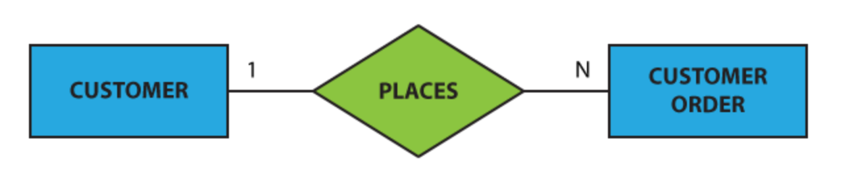
Cardinality
The cardinality of a relationship is shown on an ER model with a 1 or M on either side of the relationship
M

